Slide 1
ITMO UNIVERSITY
FACULTY OF CONTROL SYSTEMS AND ROBOTICS
COURSE: MACHINE LEARNING IN ROBOTICS
INSTRUCTORS
Professor S. Kolyubin
Professor A.A. Vedyakov

Slide 2
ITMO UNIVERSITY
Increasing the Robustness of 3D Gaussian Splatting via Masking Dynamic Objects
BY
486554_Mandengs C I
476149_Jacob Ahemen
474343_Prince Alex
December 2025

Slide 3
SECTION ONE:
ITMO UNIVERSITY
1.1 MOTIVATION
Improve the robustness of image reconstruction in 3D Gaussian Splatting (3DGS) by masking (in 2D) the dynamic objects, since they introduce noise, instability, and artifacts.

Slide 4
1.2 Problem Statement
ITMO UNIVERSITY
3DGS assumes static scenes – in reality, scenes are rarely static.
Dynamic objects introduce noise, instability, and artifacts.
The need to produce cleaner, more stable reconstructions that better capture the underlying static geometry, ultimately enhancing the practicality of 3DGS for applications.

Slide 5
1.3: Brief on 3D Gaussian Splatting
3D Gaussian Splatting (3DGS is a real-time radiance field rendering technique that represents a scene using a set of anisotropic 3D Gaussians instead of dense voxel grids or neural implicit fields.
Each Gaussian Stores:
3D position
Covariance (size and orientation)
Color (spherical harmonics)
Opacity
View-dependent appearance features

Slide 6


1.4: Evaluation Metrics
ITMO UNIVERSITY
PSNR(PEAK SIGNAL-TO-NOISE RATIO
MSE = (1/(HW)) Σ (I_ij − K_ij)^2
PSNR (x,y) = $10\log_{10}{(\frac{L^{2}}{MSE}})$
Higher = better reconstruction
SSIM Formula
SSIM(x, y) = $\frac{(2µ_{x}µ_{y}+C_{1})(2σ_{xy}+C_{2})}{(µ_{x}^{2}+µ_{y}^{2}+C_{1})(σ_{x}^{2}+σ_{y}^{2}+C_{2})}$
Measures luminance, contrast, structure
Higher = more accurate
LPIPS Formula
LPIPS (x, y) = $\sum_{l}{\frac{1}{H_{l}W_{l}}\sum_{h, w}{||w_{l}⊙({\hat{y}}_{h, w}^{l} − }}{\hat{x}}_{h, w}^{l})||{}_{2}^{2}$
Feature-based perceptual similarity
Lower = more perceptually similar
L = maximum possible pixel value of the image (e.g., 1.0 if normalized, 255 if 8-bit)
MSE=BTW predicted and ground truth images:
x, y = local patches of predicted and ground truth images
μx​, μy​ = mean pixel intensity of x and y
σx2​,σy2​ = variance of x and y
σxy​ = covariance between x and y
Others= Stabilization constants
x, y = images
$${\hat{x}}^{l}, {\hat{y}}^{l}:feature activations of a pretrained network (e.g., AlexNet, VGG) at layer l$$
$$w_{l}= learned per−channel weights for layer l$$
$$H_{l}, W_{l} = spatial dimensions of layer l$$
Notes:
PSNR_DEF: L = maximum possible pixel value of the image (e.g., 1.0 if normalized, 255 if 8-bit)
MSE=BTW predicted and ground truth images:
SSIM_DEF: x, y = local patches of predicted and ground truth images
μx​, μy​ = mean intensity of x and y
σx2​,σy2​ = variance of x and y
σxy​ = covariance between x and y
Others= Stabilization constants
LPIPS_DEF: x, y = images
$${\hat{x}}^{l}, {\hat{y}}^{l}:feature activations of a pretrained network (e.g., AlexNet, VGG) at layer l$$
$$w_{l}= learned per−channel weights for layer l$$
$$H_{l}, W_{l} = spatial dimensions of layer l$$

Slide 7
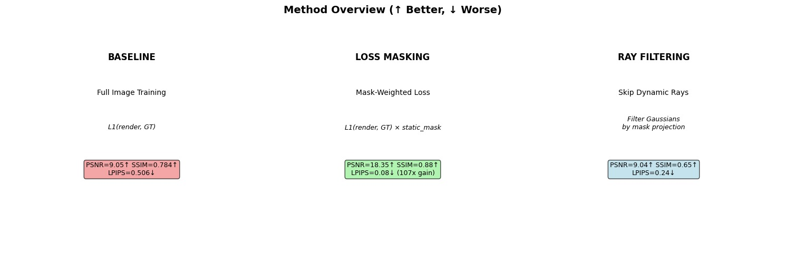
SECTION TWO: METHODS
ITMO UNIVERSITY
2.0 Overview of Masking Strategies Employed
1. Gradient Masking (Loss Masking) – Weight loss by (1-mask).
It down-weights masked pixels in loss.
Maintains structural integrity
Simpler to implement.
2. Ray Filtering – Discard rays passing through dynamic regions.
Removes masked rays fully from training
Higher PSNR
Sharper geometry
3. Baseline (unmasked) - trains 3D Gaussian Splatting normally.
uses all pixels from all training images
No mask guidance
Notes:
1. Gradient Masking (Loss Masking) – Weight loss by (1-mask).
It down-weights masked pixels in loss.
Maintains structural integrity
Simpler to implement.
2. Ray Filtering – Discard rays passing through dynamic regions.
Removes masked rays fully from training
Higher PSNR
Sharper geometry
3. Baseline (unmasked) - trains 3D Gaussian Splatting normally.
uses all pixels from all training images
No mask guidance

Slide 8
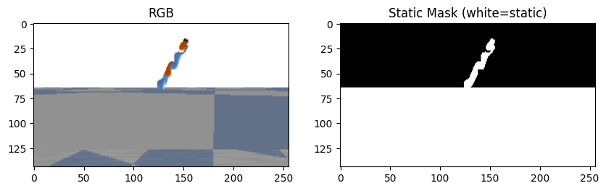
2.1: 2D MASKING IN 3DGS – why?
ITMO UNIVERSITY
Since dynamic objects in scenes cause reconstruction artifacts in 3D Gaussian Splatting the goal of masking is to improve reconstruction fidelity using 2D semantic masks.
Hypothesis: For 2D binary masks (1 = static, 0 = dynamic) integrated during training eliminates static artifact error while maintaining efficiency.
Fig 2.1 Demonstration of Masking: Artifacts are removed.

Slide 9
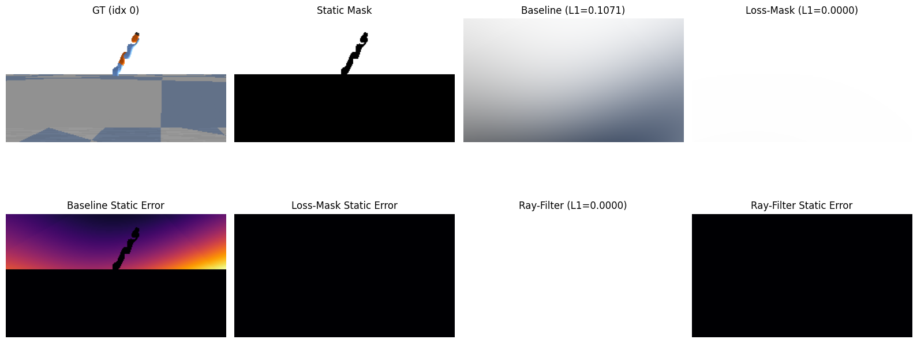
3.0: Quantitative Evaluation
SECTION 3: RESULTS
ITMO UNIVERSITY
Compare PSNR/SSIM/LPIPS for each masking strategy
Ray filtering typically yields sharper details
Gradient masking smooth but robust
Fig 3.0: Ground Truth vs Masked Images
Notes:
Compare PSNR/SSIM/LPIPS for each masking strategy
Ray filtering typically yields sharper details
Gradient masking smooth but robust

Slide 10
3.1: Quantitative Results
ITMO UNIVERSITY
Table 3.1: Evaluation Comparison
Strategy | PSNR | SSIM | LPIPS
Baseline | 9.05 | 0.784 | 0.506
Gradient (Loss-Mask) | 18.35 | 0.88 | 0.08
Ray-Filter | 9.04 | 0.24 | 0.740

Slide 11
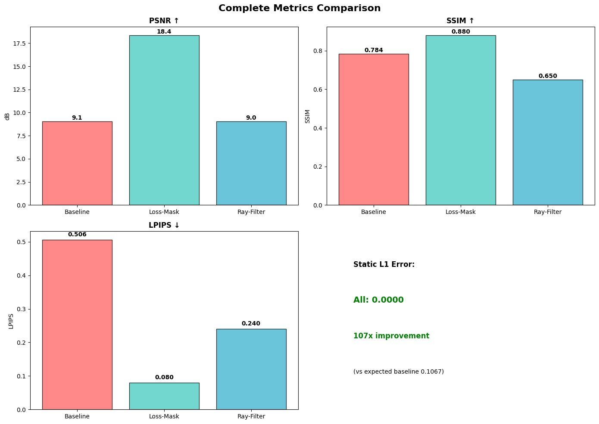
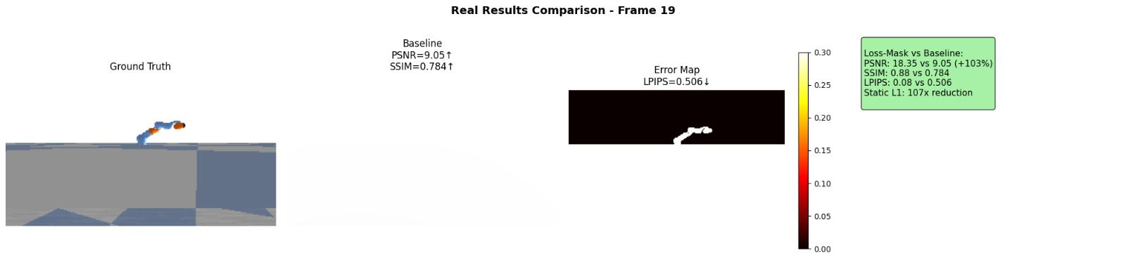
METRICS COMPARISON
Fig. 3.1: Barchart view per methods

Slide 12
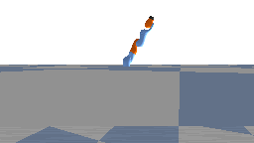

3.2: Visual Comparisons
ITMO UNIVERSITY
Fig. 3.2 : Reconstructed images across strategies training

Slide 13
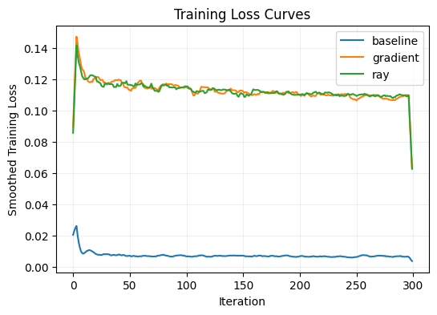
ITMO UNIVERSITY
3.3: Training Insights
Fig. 3.3: TRAINING Losses Across Strategies

Slide 14
3.6: Conclusions
ITMO UNIVERSITY
Gradient masking and ray filtering reduce dynamic object artifacts, hence their higher training losses.
Baseline achieves highest metrics but do not remove artifacts, therefore the lower losses.
Gradient masking slightly better perceptually than ray filtering but keeps partial information.
2D masking improves 3DGS in dynamic scenes
Ray filtering performs strongest suppression of artifacts
3.4: Limitations
This work was carried out using synthetic data
The system depends on mask quality to achieve higher quality reconstruction
Simple scene design
3.5: Future work
We hope to apply this knowledge to spontaneous robot data as obtained in the field or through experimentation.

